Slide 1


Connectivity Project Update
Stakeholder Engagement
Amaryllis Hotel-Blantyre
Presented By
Chiyembekezo Chekani-TPM
24th March, 2026

Slide 2
Digital Malawi Acceleration project (DMAP)
COMPONENT DESCRIPTION
Component 1:Affordable Broadband and secure Data platforms

Slide 3
Digital Malawi Acceleration project (DMAP)
Summary of Key Deliverables (Overview)
Scope | Target
Commercial Transaction Manual (CTM) | 1
Rural underserved broadband Towers | 91*** sites
Public Institution Connectivity (PIC) | 500 sites
Upgrade of GWAN Core Network | Various (Routers, Switches, Firewalls etc)
GWAN Managed Services | Various (Campus Network, GLAN sites, GWAN Optic Fiber backbone).
Schools Connectivity | 2,000
IP Transit (Internet) | TBA

Slide 4
Digital Malawi Acceleration Project (DMAP)
Project Update
Public Institution Connectivity, NRB and Ministry of Lands (Overview)
All the assessment were done jointly by Department of e-Government, Ministry of Information, Communications and Digitalization, National Registration Bureau (NRB), Ministry of Lands, Technical staff from all District Councils (Lands/Estate, Environment and ICT) and PPPC (Safeguards and ICT)
SCOPE | CRITERIA
Public Institution Connectivity-PIC | 514 sites from DIGMAP site Database 787 sites from District Consultations with DEC In total we had 1301 sites for technical and Safeguard assessment
National Registration Bureau (NRB) | The list was provided by NRB which included mainly Post Offices, Health Centers, 319 sites were proposed.
Land Information Management Systems (LIMS) | The list was provided by Ministry of Lands which included DC offices and Traditional Authorities and Village Headmen (Land Clerks), 329 sites were proposed.

Slide 5
Digital Malawi Acceleration Project (DMAP)
Project Update
Rural Mobile Broadband Towers(Overview)
    The assessment was done jointly by the Ministry of Information, Communications and Technology, Department of e-Government, MACRA, USF, Technical Officers from Districts (Lands/Estate, Environment, ICT) and the PPPC (Safeguards and ICT).
SCOPE | CRITERIA
Rural Underserved Areas | List shared by MACRA/USF and list compiled through reports received by MACRA on coverage gaps, drive tests by MACRA and though Parliament sitting. The initial list was 93 and 9 were added and recently surveyed.

Slide 6
Digital Malawi Acceleration Project (DMAP)
Key Information Collected during the Technical and Safeguard assessment
3. Rural Underserved Mobile Towers
Description | RATIONALE
Site Information | Get unique location and description
Grid Power (ESCOM) | Primary requirement for consideration (PIC, NRB and LIMS)
Availability of existing Towers | Ensure no standalone sites and decide repeater sites
Terrain | Helps planning for coverage and access of the tower
Economic Activities | Revenue projection and deciding Maximum Allowable Subsidy (MAS)
Estimated Population | Viability and planning purposes and MAS calculation

Slide 7
Digital Malawi Acceleration Project (DMAP)
PRESENTATION OF TECHNICAL ASSESSMENT
a. Public Institution Connectivity (PIC) and LIMS
A total of 1301 site were consolidated and considered for technical assessment
Total Number of consolidated sites 1301
Sites without electricity but assessed 0223
Sites without electricity but not assessed plus schools removed from the list 0286
Sites with Electricity 0792
1,301 Public Institution Sites (PIC) 0683 Ministry of Lands 0109
0792
Total potential sites for connection 0792

Slide 8
Digital Malawi Acceleration Project (DMAP)
PRESENTATION OF TECHNICAL ASSESSMENT
a. Public Institution Connectivity and LIMS (Sites Distribution by District)
# NO | DISTRICT | PIC | LIMS | TOTAL
1 | Balaka | 17 | 2 | 19
2 | Blantyre | 70 | 6 | 76
3 | Chikwawa | 14 | 4 | 18
4 | Chiradzuru | 17 | 3 | 20
5 | Chitipa | 18 | 6 | 24
6 | Dedza | 24 | 0 | 24
7 | Dowa | 28 | 1 | 29
8 | Karonga | 18 | 4 | 22
9 | Kasungu | 17 | 9 | 26
10 | Likoma | 15 | 0 | 15
11 | Lilongwe | 50 | 4 | 54
12 | Machinga | 18 | 3 | 21
13 | Mangochi | 42 | 5 | 47
14 | Mchinji | 11 | 3 | 14

Slide 9
Digital Malawi Acceleration Project (DMAP)
PRESENTATION OF TECHNICAL ASSESSMENT
a. Public Institution Connectivity and LIMS (Sites Distribution by District)
15 | Mulanje | 19 | 4 | 23
16 | Mwanza | 13 | 3 | 16
17 | Mzimba | 51 | 5 | 56
18 | Neno | 16 | 0 | 16
19 | Nkhatabay | 17 | 6 | 23
20 | Nkhotakota | 15 | 5 | 20
21 | Nsanje | 29 | 2 | 31
22 | Ntcheu | 32 | 6 | 38
23 | Ntchisi | 12 | 1 | 13
24 | Phalombe | 26 | 3 | 29
25 | Rumphi | 22 | 6 | 28
26 | Salima | 22 | 5 | 27
27 | Thyolo | 23 | 9 | 32
28 | Zomba | 27 | 4 | 31
TOTAL # OF SITES |  |  |  | 792

Slide 10
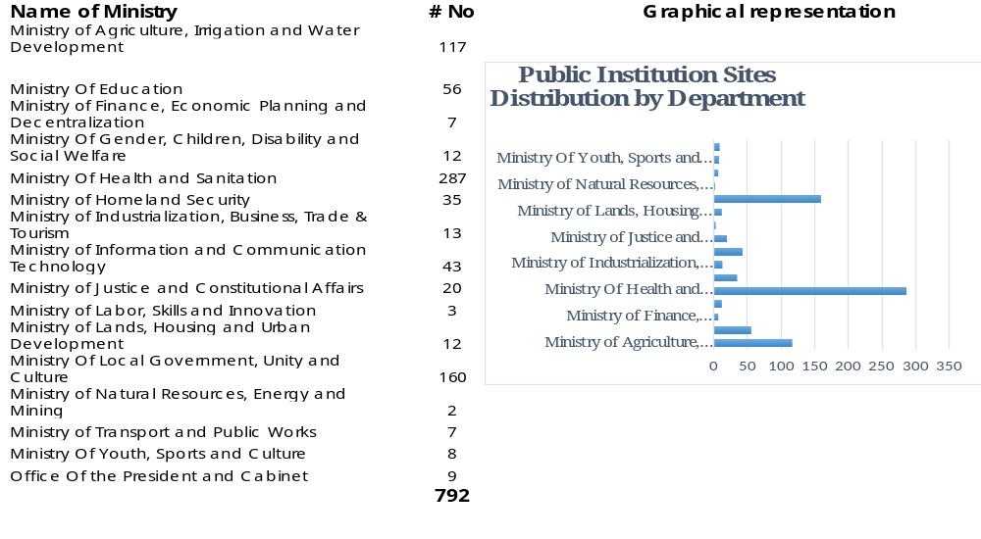
Digital Malawi Acceleration Project (DMAP)
PRESENTATION OF TECHNICAL ASSESSMENT
a. Public Institution Connectivity and LIMS (Sites Distribution by Ministry)

Slide 11
Digital Malawi Acceleration Project (DMAP)
PRESENTATION OF TECHNICAL ASSESSMENT
b. National Registration Bureau
There were 319 sites in total for assessment
Total Number of Consolidated sites 319
Sites connected but need upgrade 104
Sites connected that do not need an upgrade 057
161
Sites without Electricity 106
Sites with electricity and need new connection 052
158

Slide 12
Digital Malawi Acceleration Project (DMAP)
PRESENTATION OF TECHNICAL ASSESSMENT
b. National Registration Bureau (Distribution by District)
# No\ | DISTRICT | NUMBER OF SITES
1 | Balaka | 1
2 | Blantyre | 5
3 | Chikwawa | 1
4 | Chitipa | 1
5 | Dowa | 2
6 | Kasungu | 2
7 | Lilongwe | 5
8 | Machinga | 1
9 | Mangochi | 5
10 | Mulanje | 2
11 | Mzimba | 4
12 | Nkhatabay | 1
13 | Nkhotakota | 6
14 | Ntchisi | 5
15 | Phalombe | 2
16 | Rumphi | 3
17 | Salima | 2
18 | Thyolo | 1
19 | Zomba | 3
Total Sites |  | 52

Slide 13
Digital Malawi Acceleration Project (DMAP)
PRESENTATION OF TECHNICAL ASSESSMENT
c. Rural Underserved Areas Mobile Towers
# No | DISTRICT | # PROPOSED SITES
1 | Balaka | 1
2 | Chikwawa | 2
3 | Chitipa | 13
4 | Dedza | 4
5 | Dowa | 3
6 | Karonga | 5
7 | Kasungu | 4
8 | Likoma | 2
10 | Machinga | 5
11 | Mangochi | 10
12 | Mchinji | 3
13 | Mulanje | 3
14 | Mwanza | 1
15 | Mzimba | 6
16 | Neno | 3
17 | Nkhata-Bay | 3
18 | Nkhotakota | 4
19 | Ntcheu | 3
20 | Ntchisi | 3
21 | Rumphi | 5
22 | Salima | 2
23 | Thyolo | 1
24 | Zomba | 5
Total sites |  | 91

Slide 14
Digital Malawi Acceleration Project (DMAP)
PRESENTATION OF TECHNICAL ASSESSMENT
c. Rural Underserved Areas Mobile Towers
    Assessed sites consolidated with both Technical and Safeguard requirements
    The site list was validated by key Mobile Network Operators (MNOs) including Telekom Networks Plc, Airtel Malawi Limited, Helios (Malawi Towers Limited) MACRA, USF, the Department of e-Government and the PPPC (Safeguard)
    Site candidates confirmed, PoP mapped for each proposed site with tower heights also confirmed
    Maximum Allowable Subsidy (MAS) has been proposed for each site
    MAS calculation is based on availability of ESCOM, Terrain, Economic activities, PoP presence and Estimated Population
    Sites with available ESCOM score less (Max 10 points) and have less MAS
    Sites with hard-terrain score high (Max 20 points) and have high MAS
    Sites with more economic activities score less (Max 20 points) and have less MAS
    Sites with high estimated population score less (Max 30 points) and have less MAS

Slide 15
Digital Malawi Acceleration Project (DMAP)
Kay Technical Challenges
    Access in hard-to-reach areas
    There are places with no proper roads for cars, in some areas please walk long distance (More than 6Km) and in some areas people have to hire private motorcycles. This is delaying completion of the technical assessment
    2. Sites without electricity
    There are many potential sites that have no ESCOM power especially on Public Institution Connectivity. Need to work with complimenting projects (Power) to consider those sites in future.
    Utilizing Existing Infrastructure for connectivity
    Use ESCOM poles in Optic Fiber installation, reduce FOREX expenditure on importing poles, reduce implementation time. MoICT and MACRA/USF to facilitate co-sitting with ESCOM, ensure no expoitation in pricing co-sitting partners because of monopoly.

Slide 16
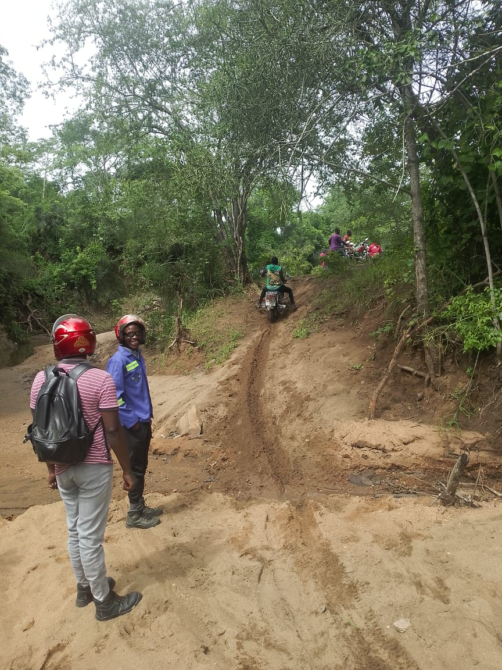

Slide 17
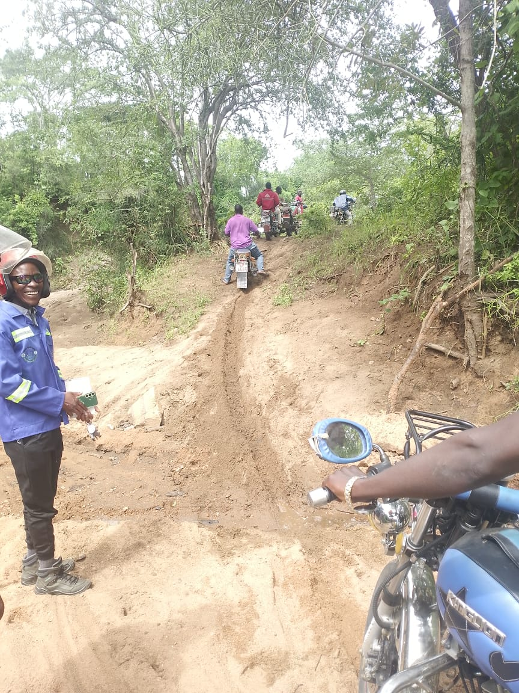

Slide 18


Slide 19
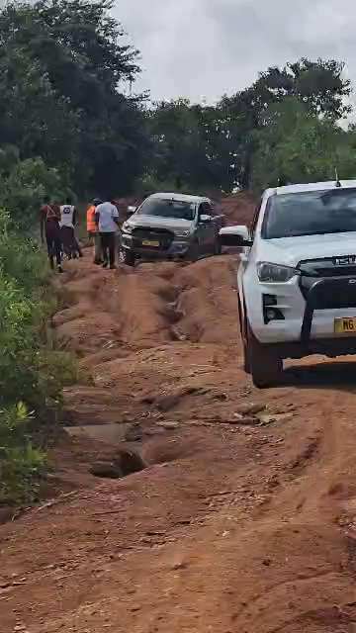

Slide 20
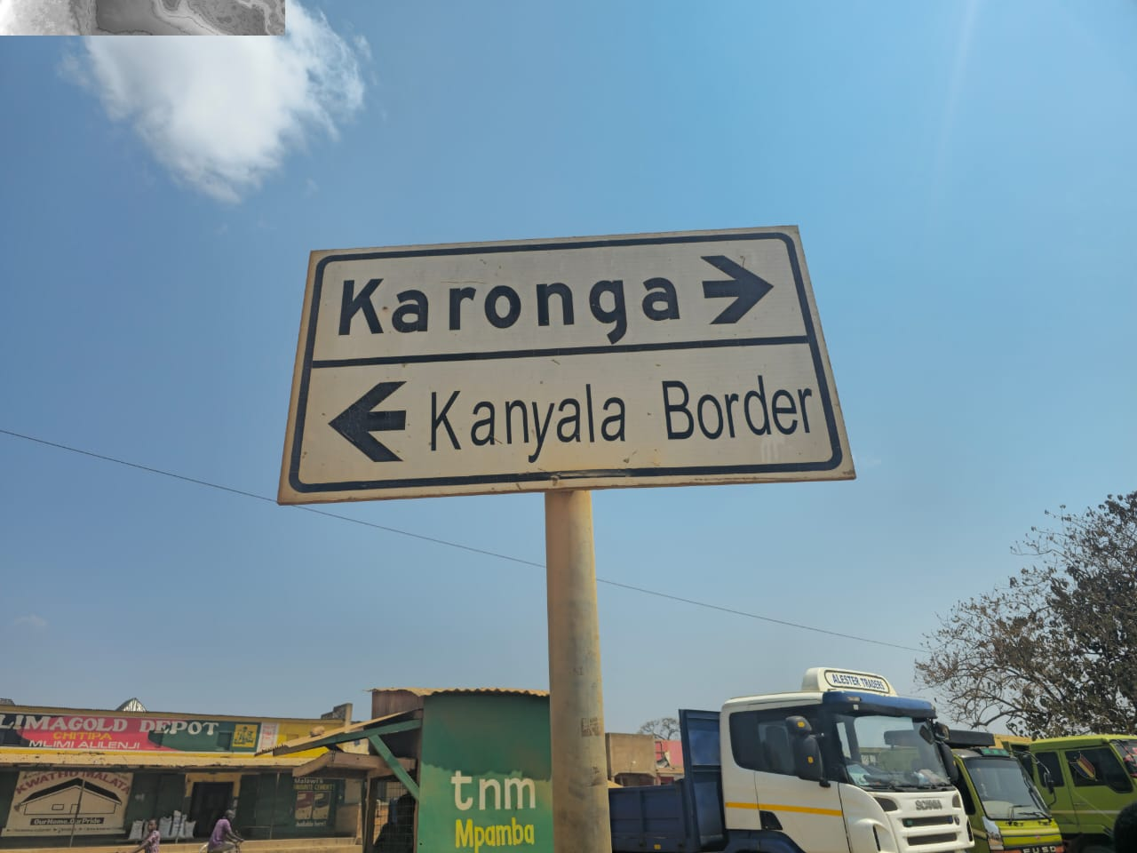

Slide 21
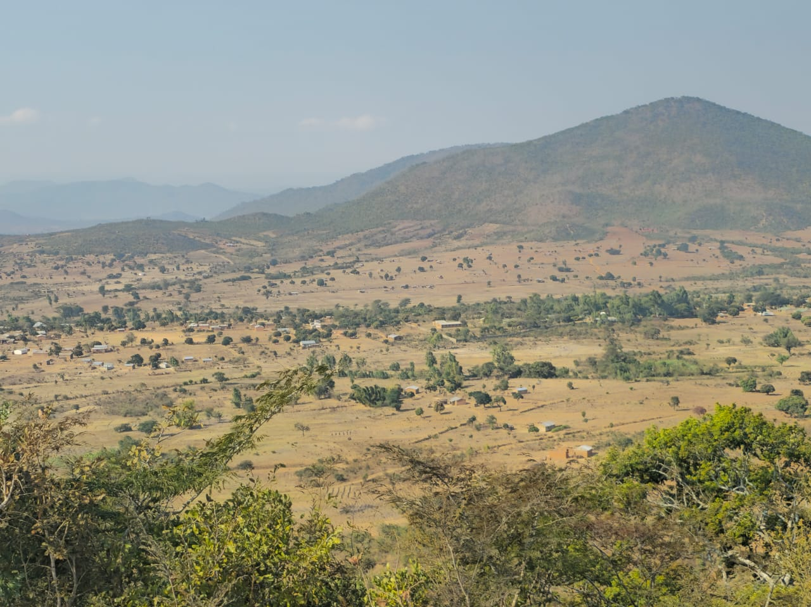

Slide 22
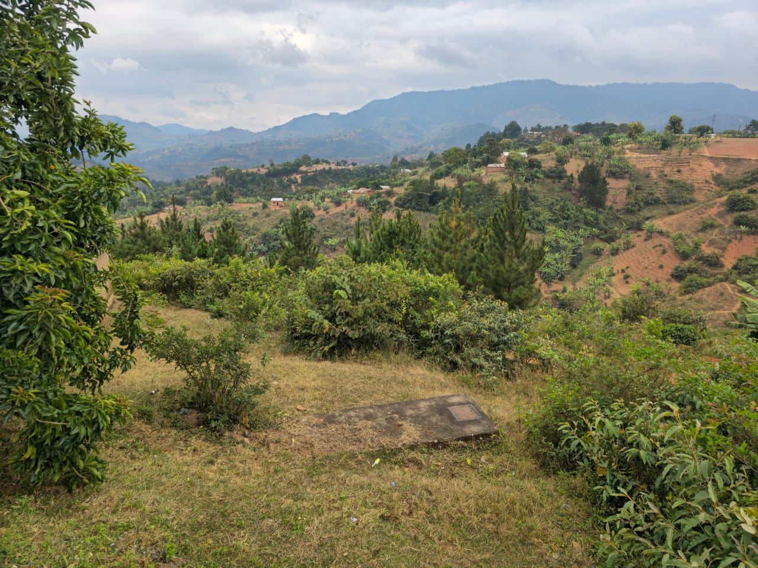

Slide 23
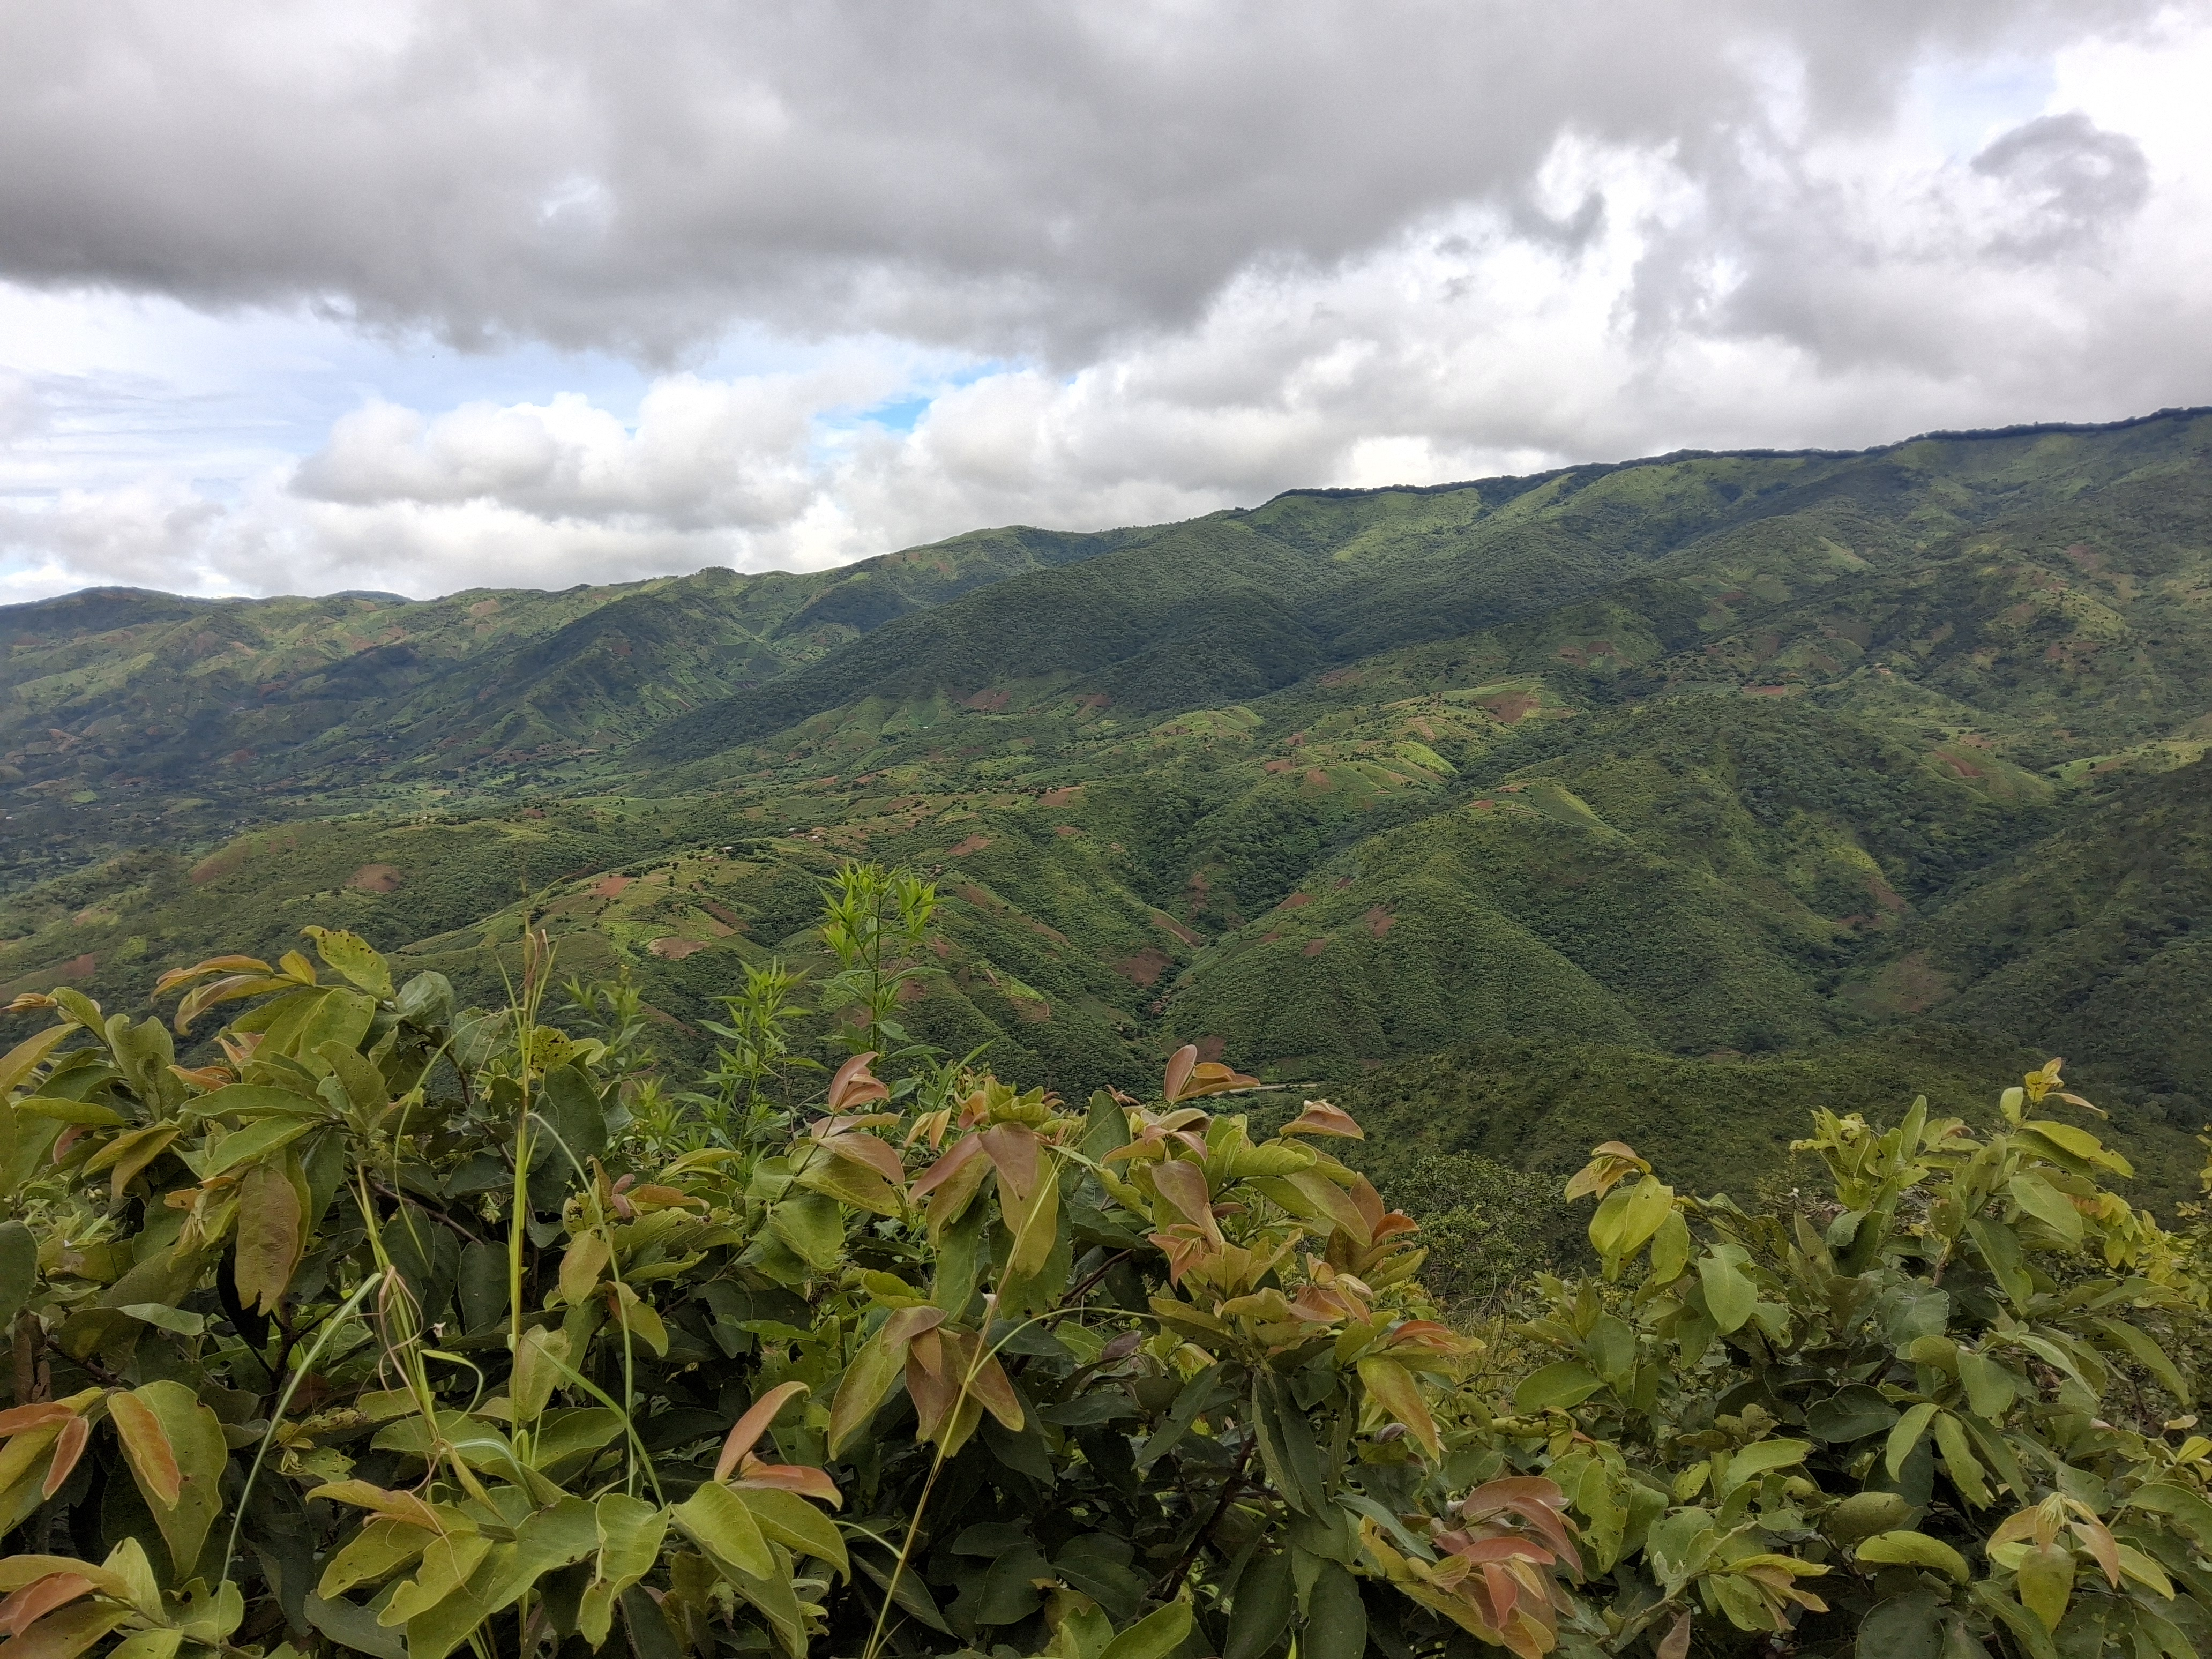

Slide 24
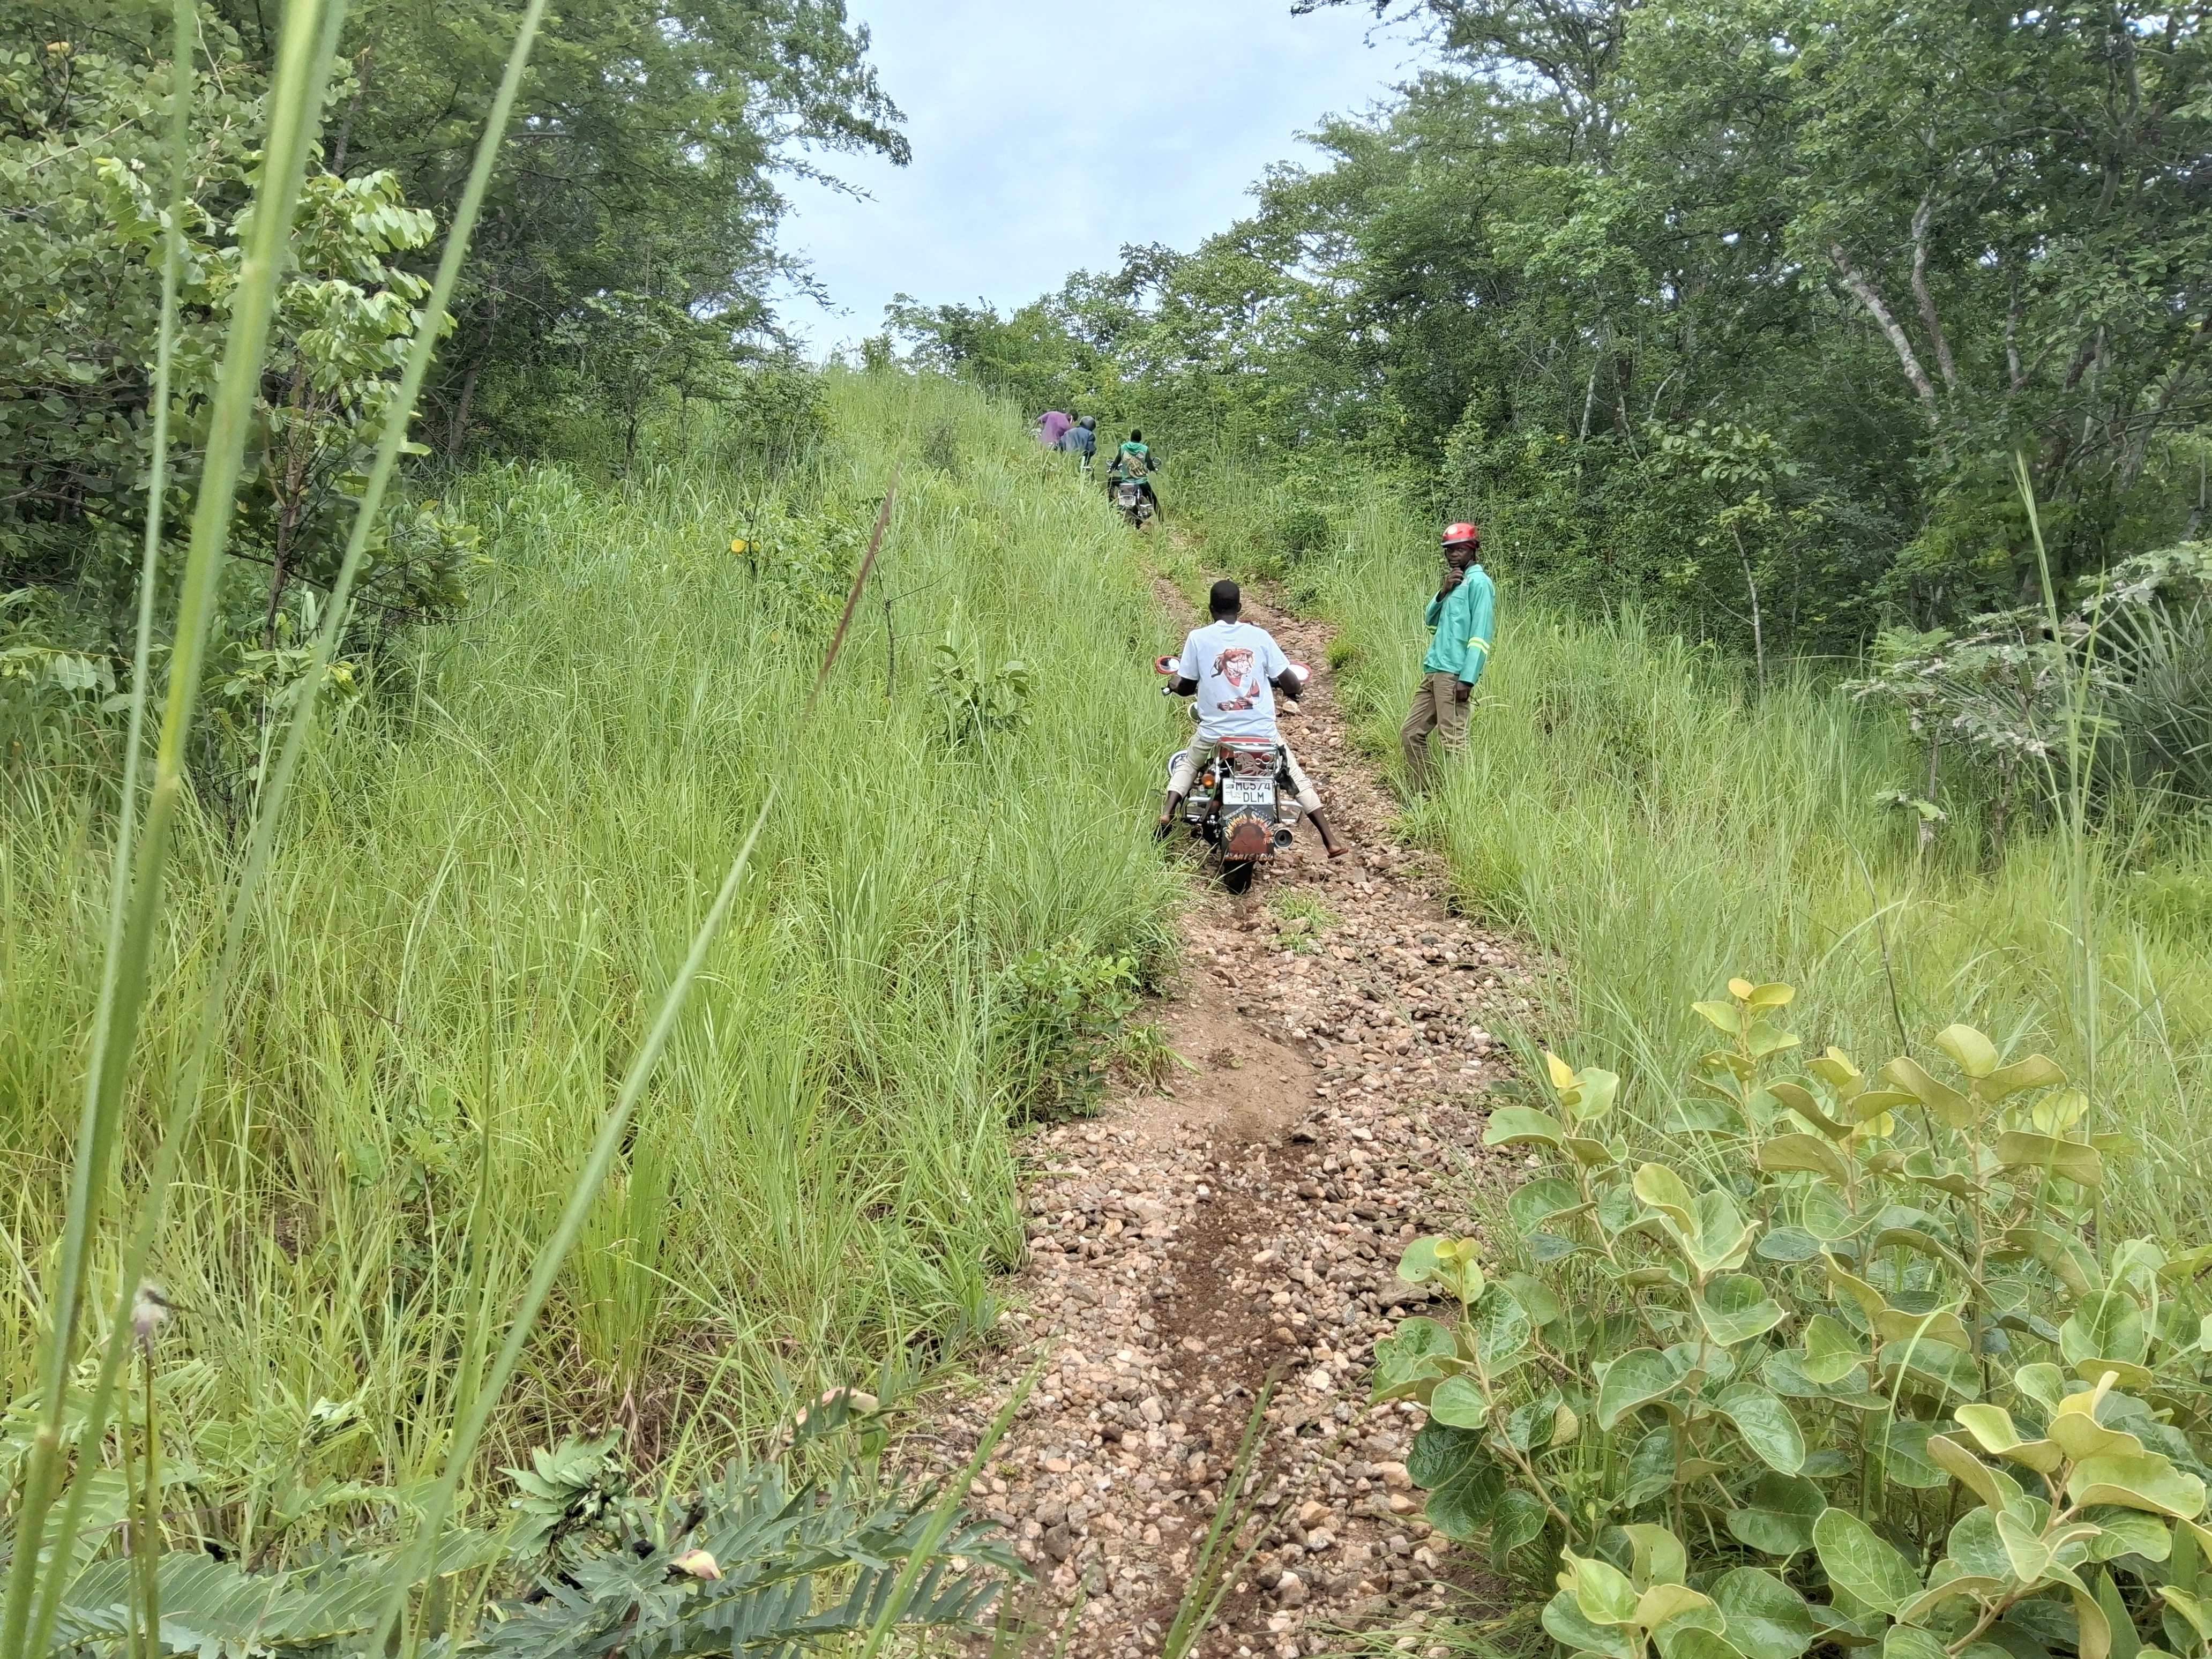

Slide 25
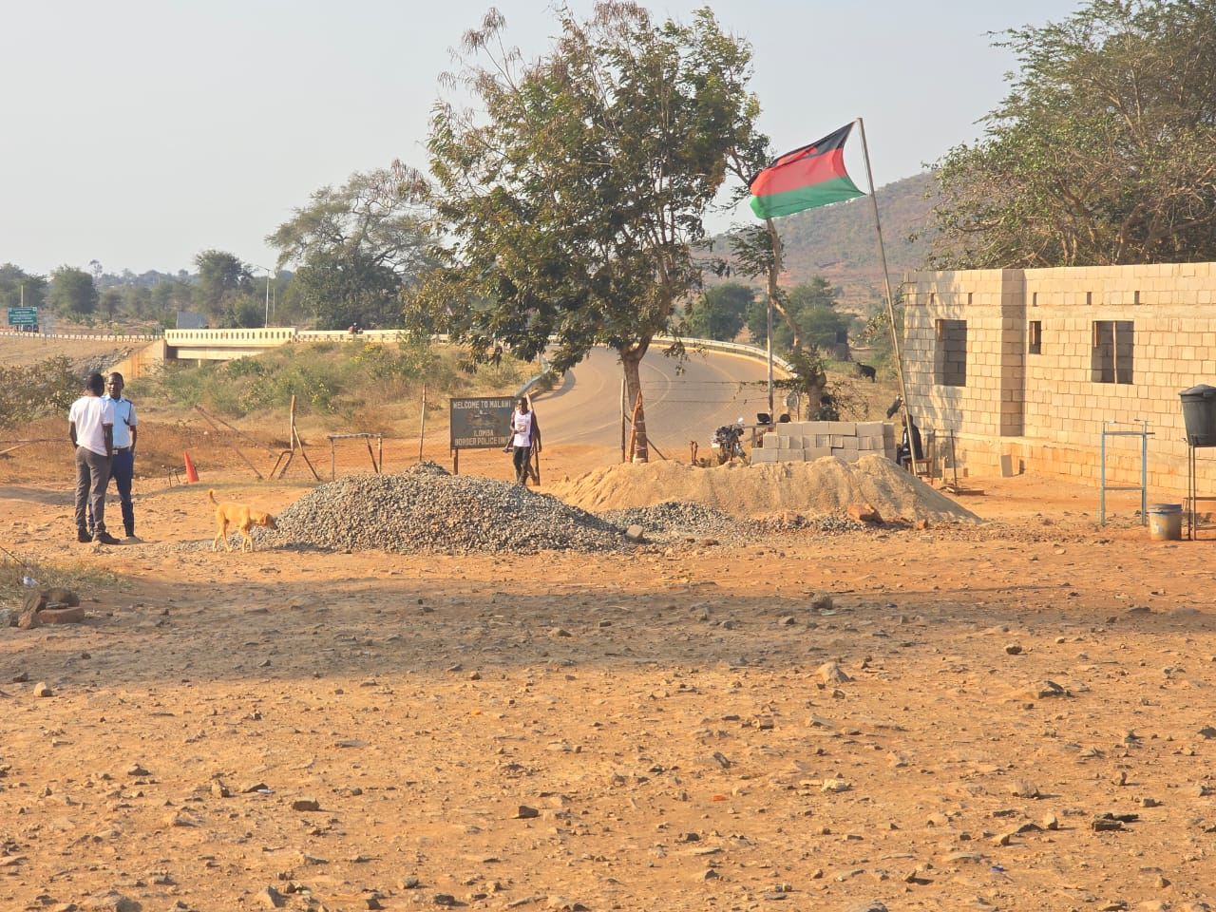

Slide 26
Digital Malawi Acceleration Project (DMAP)
ROADMAP (CONNECTIVITY)-Current
SCOPE | TARGET | PROCUREMENT | COMMENT
Rural Underserved Mobile Broadband (Towers) | 91 Sites*** | April, 2026 | Pending finalization of RFB
Public Institution Connectivity (PIC including Ministry of Lands and NRB sites) | 500 sites | May, 2026 | Pending finalization of CTM and RFB

Slide 27
Digital Malawi Acceleration Project (DMAP)
ROADMAP (CONNECTIVITY)-Upcoming
SCOPE | TARGET | PROCUREMENT | COMMENT
Upgrade of Core GWAN Network | Various | TBA | Pending finalization of RFB
GWAN Managed Services (Fiber Maintenance and NOC Services) | Various | TBA | Pending finalization of RFB
Connections to school | Various | TBA | Planned in DMAP Phase 2 (2028-2030)
IP Transit | TBA | TBA | Pending finalization of RFB

Slide 28
The End..

